Slide 1
Introduction to Basic Statistical Concepts for Science Teachers and Applications for Student Research Projects
Ryan Tolman
March 9th, 2013
Workshop presented at The Kohala Center HI-MOES Teachers Meeting
Waimea, HI
Notes:
Introductions
[Pass out the Pre-Evaluation Survey]

Slide 2
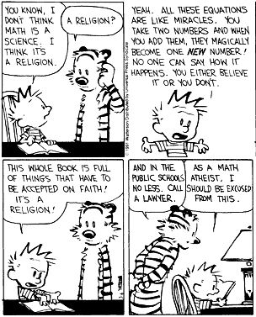
Notes:
On question #1 of the pre-evaluation survey, “The thought of having to do statistics is scary to me”, how many of you answered “Very Scary”? How many of you answered “somewhat scary”? How many “not at all scary”?
One of the over-arching goals for this workshop is to try and make statistics a little less scary for everyone here. And if you’re not scared by statistics, maybe I will be able to teach you some new things that can be applied in your teaching.

Slide 3
Overview of Workshop Contents
Introduction to Basic Statistical Concepts for Student Science Class Projects
In-Class Examples of Teaching Statistical Concepts
Resources for Applying Statistical Decision-Making to Student Research Projects
Resources and References

Slide 4
I. Introduction to Basic Statistical Concepts for Student Science Class Projects
Purpose and Goals of the Workshop
What are Statistics? (Definitions? Uses? Etc.)
Review of Foundational Concepts in Statistics
Statistics Throughout the Research Process

Slide 5
A. Purpose of the Workshop
“Science isn’t show and tell. It’s a test or an experiment where you get repeatable, demonstratable results.”
“How do we determine if the results are statistically significant?”
Notes:
Refer to question #2 on the pre-evaluation survey
Science isn’t show and tell. It’s a test or an experiment where you get repeatable, demonstratable results. - Dad
How do we determine if the results are statistically significant? – Megan Dehning
Transition to the goals by discussing the challenges of trying to teach someone everything about statistics in only a 3 hour workshop, however, at the end of the day, I want to provide them with the tools and resources to conduct simple tests of significance. I’m not going to teach all of the formulas, but rather give them some tools and resources that they can use to test for significance. as well as provide them with some useful teaching examples to teach important concepts of inferential statistics.

Slide 6
A. Goals of the Workshop
Learn basic concepts in statistics that are important to the research process.
Learn how statistics are applied throughout the stages of the scientific research method.
Provide hands-on examples of doing statistics to learn statistical concepts.
Determine what statistical analysis to use based on the research design.
Apply statistical analyses to examples of HI-MOES student research projects.

Slide 7
B. What Are Statistics?
Notes:
[WHITE BOARD ACTIVITY]:
Ask the teachers what they think statistics are? What does it mean to them? What do statisticians do?
Over the next set of slides, go through and highlight
Items that the teachers listed,
Some of the items that weren’t listed
Some of the additional things that the listed but weren’t mentioned
Highlight
The difference between mathematical statistics and the application of statistics
The application of statistics can involve all stages of the research process
However, there are some useful applications for mathematical statistics in summarizing, graphing, and communicating data
Difference between descriptive and inferential statistics

Slide 8
What Are Statistics?
Mathematical Statistics: procedures for dealing with numbers.

Slide 9
Much of Statistics is Actually Non-Mathematical
Study of the collection, organization, analysis, interpretation, and presentation of data.
Statistics deals with all aspects of the research process.
  Planning of data collection in terms of the design of surveys and experiments.

Slide 10
Descriptive and Inferential Statistics
Descriptive Statistics: Methods to summarize or describe a collection of data.
Inferential Statistics: Statistical models that are used to draw inferences about the process or population under study.
  Provides a way to draw conclusions from data that are subject to random variation.
  Conclusions are tested as part of the scientific method.

Slide 11
Statistics and Probability Theory
Probability Theory: starts from the given parameters of a total population to deduce probabilities that pertain to samples.
Statistical Inference: moves in the opposite direction—inductively inferring from samples to the parameters of a larger or total population.

Slide 12
What Statistics Are to Me:
Problem-solving
A set of tools
Story telling

Slide 13
C. Foundational Concepts in Statistics

Slide 14
Terminology
Populations & Samples
Population: the complete set of individuals, objects or scores of interest.
  Often too large to sample in its entirety
  It may be real or hypothetical (e.g. the results from an experiment repeated ad infinitum)
Sample: A subset of the population.
  A sample may be classified as random (each member has equal chance of being selected from a population) or convenience (what’s available).
  Random selection attempts to ensure the sample is representative of the population.

Slide 15
Variables
Variables are the quantities measured in a sample.They may be classified as:
  Quantitative
    Interval, i.e. numerical
  Categorical
      Nominal (e.g. gender, blood group)
      Ordinal (ranked e.g. mild, moderate or severe illness). Often ordinal variables are re-coded to be quantitative.

Slide 16
Variables
Variables can be further classified as:
  Dependent/Response. Variable of primary interest (e.g. blood pressure in an antihypertensive drug trial). Not controlled by the experimenter.
  Independent/Predictor
    called a Factor when controlled by experimenter. It is often nominal (e.g. treatment)
    Covariate when not controlled.
If the value of a variable cannot be predicted in advance then the variable is referred to as a random variable

Slide 17
Parameters & Statistics
Parameters: Quantities that describe a population characteristic. They are usually unknown and we wish to make statistical inferences about parameters.
Descriptive Statistics: Quantities and techniques used to describe a sample characteristic or illustrate the sample data e.g. mean, standard deviation, box-plot

Slide 18
Measures of Central Tendency (Location)
Measures of location indicate where on the number line the data are to be found. Common measures of location are:
(i) the Arithmetic Mean,
(ii) the Median, and
(iii) the Mode

Slide 19
Measures of Dispersion
Measures of dispersion characterise how spread out the distribution is, i.e., how variable the data are.
Commonly used measures of dispersion include:
  Range
  Variance & Standard deviation
  Coefficient of Variation (or relative standard deviation)
  Inter-quartile range

Slide 20
Statistical Inference
Statistical Inference – the process of drawing conclusions about a population based on information in a sample
Notes:
Population must be defined so that it follows that a sufficiently large sample would be representative of the population
Whether or not a sample is representative of a population depends on (i) how individuals in sample are chosen and (ii) what is being measured.
Non-random sampling can lead to Sampling Bias, i.e., tendency for some individuals to be selected more readily that others. A different type of non-randomness is selection of individuals such that the variation among individuals in the sample is not representative of the underlying variability in the population, i.e. the sample is too homogenous.

Slide 21
Statistical Inference
Population
(parameters, e.g., μ and σ)
select sample at random
Sample
collect data from individuals in sample
Data
Analyse data (e.g. estimate ) to make inferences

Slide 22
The Normal Distribution
The Normal distribution is considered to be the most important distribution in statistics
It occurs in “nature” from processes consisting of a very large number of elements acting in an additive manner
However, it would be very difficult to use this argument to assume normality of your data
  Later, we will see exactly why the Normal is so important in statistics

Slide 23
Normal curve
0.68
0.95
0.997
μ - 3σ
μ - 1.96σ
μ - σ
μ
μ + σ
μ + 1.96σ
μ + 3σ

Slide 24
Sampling distribution of Sample Means
95% of the ‘s lie between
95%

Slide 25
How close is Sample Statistic to Population Parameter ?
Population parameters, e.g. μ and σ are fixed
Sample statistics, vary from sample to sample
How close is the sample mean to the population mean?
  Cannot answer question for a particular sample
  Can answer if we can find out about the distribution that describes the variability in the random variable

Slide 26
Statistical Models
Statistical Models:
  Fitting statistical models to data that represent the hypotheses that we want to test.
  Use probability to see whether scores are likely to have happened by chance.
Testing Statistical Models:
  Compare the systematic variation against the unsystematic variation.
  In other words, how good the model/hypothesis is at explaining the data against how bad it is (the error):
Outcome = Model + error

Slide 27
Test Statistic = Variance/Unexplained Variance
Systematic and Unexplained Variance
  Systematic variation: variation due to some genuine effect.
  Unsystematic variation: variation that isn’t due to the effect in which the researcher is interested, variation that can’t be explained by the model.
Test statistic = [variance explained by the model/variance not explained by the model] = [effect/error]
Essentially, most statistical tests calculate the amount of variance explained by the model we’ve fitted to the data compared to the variance that can’t be explained by the model.
  If the model is good, we would expect it to explain more of the variance in the data.

Slide 28
D. Statistics Throughout the Research Process
Notes:
What types of questions do statisticians ask through each stage of the research process?
How are statistics applied through each stage of the research process?

Slide 29
Notes:
Figure demonstrating statistics role throughout the research process.
Each stage affects the theory and is affected by it as well.
Statistics may be most closely associated with the data analysis stage, but in fact, we will see how statistics play a role in all stages of the research process.

Slide 30
Notes:
Figure demonstrating how the process of generating theories can inform your process of collecting data and analysis, and how your data collection and analysis can inform your theories.

Slide 31
Workshop Activity #1: What Statistical Questions Are Asked During Each Stage of the Research Process?
Stage of the Scientific Research Process | Statistical Questions that Can Be Asked at Each Stage of Research
Create a Research Question
Gather Information on the Topic
Create a Hypothesis
Design Methods and Procedures
Collect Data
Analyze Data
Make Conclusions
Communicating Your Findings
Notes:
In the space below, briefly describe an example of a current student research study project. Briefly state the research question, the predictions, and the procedures.
Next, in the space in the right hand column titled, take notes on questions that you can ask at each stage during the scientific research process.
WORK THROUGH EXAMPLE OF STATISTICAL QUESTIONS TO ASK DURING EACH STAGE OF THE RESEARCH PROCESS:

Slide 32
Workshop Activity #2: Applying Statistics to Each Stage of the Research Process?
Stage of the Scientific Research Process | Statistical Issues at Each Stage of the Research Process
Create a Research Question
Gather Information on the Topic
Create a Hypothesis
Design Methods and Procedures
Collect Data
Analyze Data
Make Conclusions
Communicating Your Findings
Notes:
Many statistical answers can be answered prior to even conducting your research study. In this exercise, try and address as many of the statistical issues that you can regarding a current student research project that you are working on.
In the space below, briefly describe an example of a current student research study project (or use the previous example). Briefly state the research question, the predictions, and the procedures.
Next, in the space in the right hand column, try and address some of the statistical questions that can be answered during the pre-planning stages of a research study.
WORK THROUGH AN EXAMPLE:

Slide 33
What Have We Learned So Far?
What Statistics Are
  Deals with all stages of the research process
  Statistical Inference
Key Concepts in Statistics
  Sampling from a Population
  Types of Variables
  Measures of Central Tendency and Dispersion
  Normal Distribution
  Statistical Model and Test Statistic
Statistics Role Throughout the Research Process
  Questions asked by statisticians in research
  Applying statistics throughout the research process

Slide 34
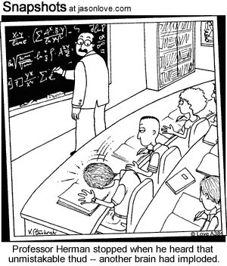

Slide 35
II. In-Class Examples of Teaching Statistical Concepts
Random Sampling w/ M&M’s
Using Statistics to Test Hypotheses in Excel

Slide 36
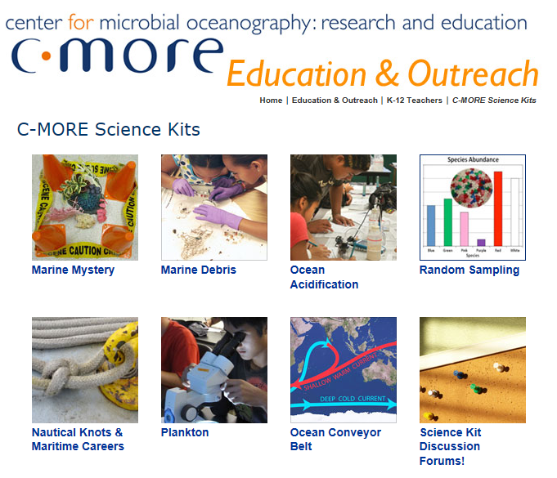
Notes:
C-MORE Science Kits: http://cmore.soest.hawaii.edu/education/teachers/science_kits.htm
Center for Microbial Oceanography: Research and Education (2013). C-MORE Science Kits: Random Sampling [Educational materials]. Retrieved from http://cmore.soest.hawaii.edu/education/teachers/science_kits/materials/Random_Sampling/Random_Sampling_Binder_Materials.pdf

Slide 37
A. Random Sampling w/ M&M’s
Why do researchers collect samples instead of measuring the entire population?
Why is it important that researchers collect samples randomly?
What is the connection between random sampling and statistics?

Slide 38
B. Using Statistics to Test Hypotheses in Excel
When there is a difference observed in the random samples collected by researchers, how can they tell that the difference is statistically significant?
Utilize the Chi-Square Goodness-of-Fit Statistic to Test a hypotheses regarding the frequency distribution of different colors of M&M’s.

Slide 39
What Did We Learn in This Example?
Association between concepts of random sampling in statistics and applications in research.
Difference between “descriptive” and “inferential” statistics.
Make the association between different stages of the research process and the application of statistics.
Learning statistical applications through hands-on examples.

Slide 40
III. Resources for Applying Statistical Decision-Making to Student Research Projects
Statistical Decision Tree
Statistics Calculators

Slide 41
A. Statistical Decision Tree
Statistical analyses can be thought of as a set of tools.
One must select the right tool for the job.
What information do you need to know to decide what statistical analysis to use?
Notes:
Use examples from current student research projects
Ask the teachers about some of their student research projects, and use those as examples to walk through some of the statistical decision trees.

Slide 42
What Information is Needed to Decide What Statistical Analysis to Use?
What type of research question are you asking (e.g., descriptive, test of association, testing differences)?
How many variables are being measured?
How many of the variables are independent or dependent variables?
What type of measurement data is being collected (e.g., nominal, ordinal, interval)?
How is the data structured?
How many samples are being collected?
Are the data normally distributed?
What is the sample size?

Slide 43
Basic Steps in Deciding What Statistics to Use
Determine what type of research question you are asking.
Determine how many variables you have. Which ones are independent dependent variables.
Determine what type of measurement scale your data is.

Slide 44
If you know what your research question is asking, you can often determine the statistical analysis
Descriptive: Describing a sample or a population
Comparing groups: Testing for differences between two or more groups.
Associations: Examining the relationships or links between two constructs of interest.
Predictive: Does increasing (or decreasing) the value on one measure effect the value of another measure.

Slide 45
 | Type of Data
Goal | Measurement (from Gaussian Population) | Binomial (Two Possible Outcomes)
Describe one group | Mean, SD | Proportion
Compare one group to a hypothetical value | One-sample ttest | Chi-square or Binomial test**
Compare two unpaired groups | Unpaired t test | Fisher's test (chi-square for large samples)
Compare two paired groups | Paired t test | McNemar's test
Compare three or more unmatched groups | One-way ANOVA | Chi-square test
Compare three or more matched groups | Repeated-measures ANOVA | Cochrane Q**
Quantify association between two variables | Pearson correlation | Contingency coefficients**
Predict value from another measured variable | Simple linear regression or Nonlinear regression | Simple logistic regression*
Predict value from several measured or binomial variables | Multiple linear regression* or Multiple nonlinear regression** | Multiple logistic regression*
Notes:
“REVIEW OF AVAILABLE STATISTICAL TESTS”: http://www.graphpad.com/support/faqid/1790/
Provides an excellent simple table to decide on statistical test based on the type of goal of the research question or study and the type of data collected.

Slide 46
What type of measurement scale is the data?
Type | Category | Explanation | Example
Categorical | Binary | There are only two categories | dead or alive; male or female
 | Nominal | There are more than two categories | whether someone is an omnivore, vegetarian, vegan, or fruitarian
 | Ordinal | The same as a nominal variable, but the categories have a logical order | Letter grades on an exam; scales such as none; few; some; many
Continuous | Interval | Equal intervals on the variable represent equal differences in the property being measured | the difference between 6 and 8 is equivalent to the difference between 13 and 15
 | Ratio | The same as an interval variable, but the ratios of scores on the scale must also make sense | a score of 16 on an anxiety scale means that the person is, in reality, twice as anxious as someone scoring 8

Slide 47
Student Research Example
Research Question: Is there a difference in the abundance and diversity of fish close to shore and further from shore at Kahalu’u Bay?
Hypothesis: We think there will be more fish species in the water farther from shore because there is less human activity and more coral, providing a greater food source.

Slide 48
Online Resources for Deciding Which Statistical Analysis to Use
Tables
  “Review Of Available Statistical Tests” http://www.graphpad.com/support/faqid/1790/
  UCLA Stata: What statistical test should I use? http://www.ats.ucla.edu/STAT/stata/whatstat/default.htm
Decision Trees
  The Decision Tree for Statistics: http://www.microsiris.com/Statistical%20Decision%20Tree/default.htm
  Social Research Methods Selecting Statistics Decision Tree: http://www.socialresearchmethods.net/selstat/ssstart.htm

Slide 49
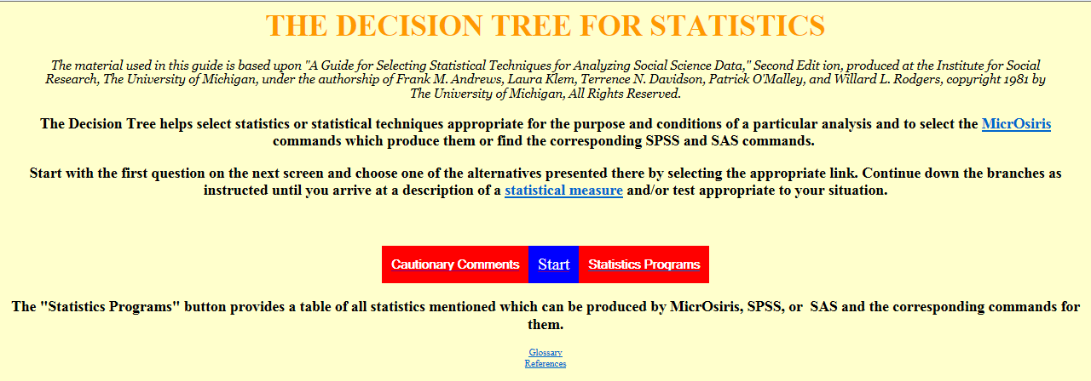
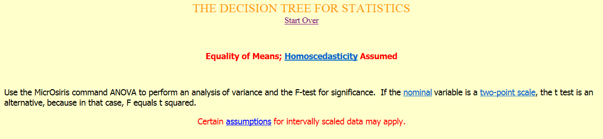
http://www.microsiris.com/Statistical%20Decision%20Tree/default.htm
Notes:
THE DECISION TREE FOR STATISTICS: http://www.microsiris.com/Statistical%20Decision%20Tree/default.htm
This is a good online resource to help guide you through what type of statistical analysis to use based on research design and type of data collected.

Slide 50
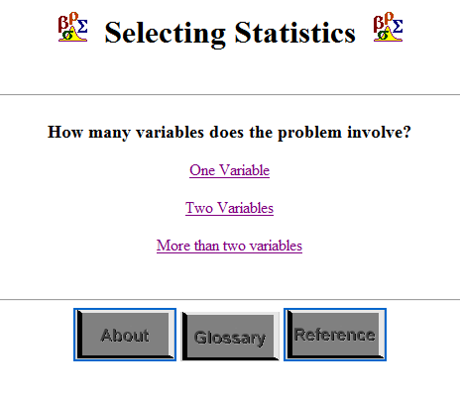
Notes:
Social Research Methods Selecting Statistics Decision Tree: http://www.socialresearchmethods.net/selstat/ssstart.htm
I find this one to be pretty good because it offers references regarding the statistical tests.

Slide 51
B. Statistics Calculators
Notes:
Briefly describe what they are and why I am recommending them.
There are lots of high-powered statistics programs that statisticians use, however, they can be pretty expensive and you may not have access to them.
In addition, you may need to know a little more about statistics than what you can learn in a three-hour workshop to use them.
Therefore, I wanted to find some resources that you would be able to apply some basic statistical analyses to the HI-MOES student research projects that you would be able to use fairly easily.
Therefore, I want to provide you with some simple, easy to use, statistics calculators that you can apply to the HI-MOES student research projects.
So now, let me walk you through some examples so that way, after the workshop, you can apply them to the student research projects.

Slide 52
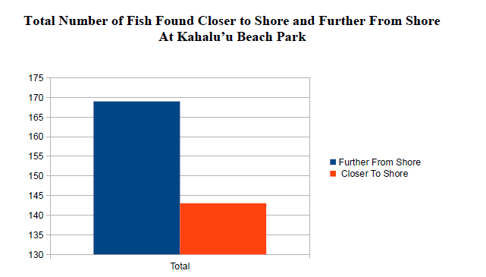
Example of Testing Statistical Significance of Student Research Findings with Statistics Calculators
Conclusion: Our hypothesis regarding the total number of fish observed in waters farther from shore versus closer to shore was supported because 54.2% of all fish surveyed were found in waters further from shore.
Even though the students found a higher percentage to support their hypotheses, are the results statistically significant?

Slide 53
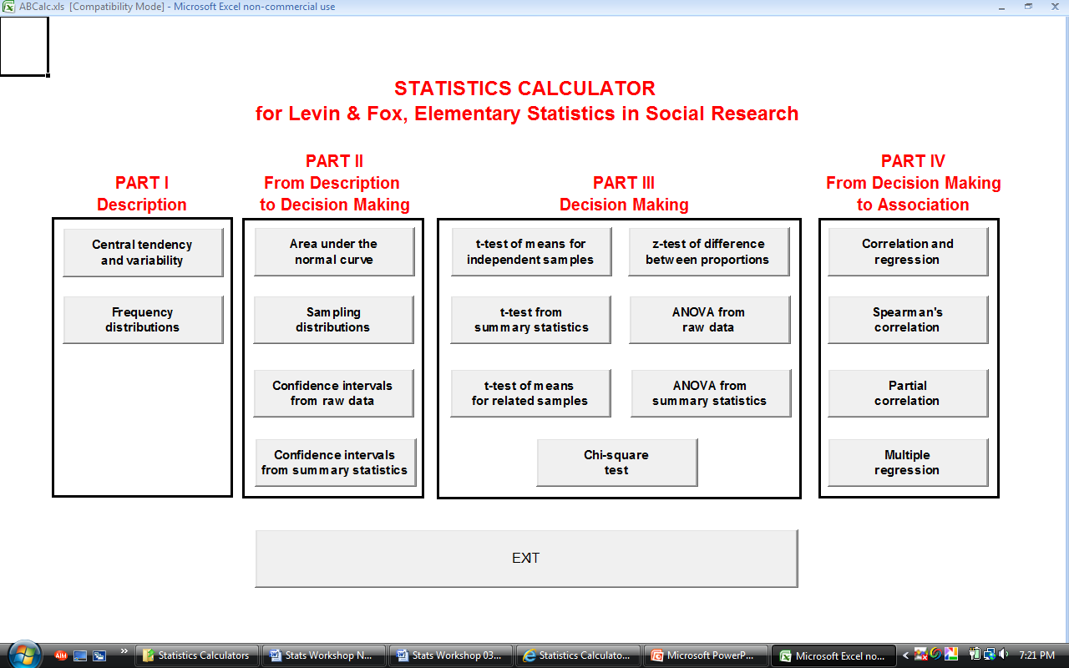
ABCalc

Slide 54
Were the students results statistically significant?
It’s important to emphasize the learning opportunities to teach the scientific method when students find non-significant results.
Technically, the hypothesis and conclusions aren’t wrong, you just failed to reject the null.
Time to go through the different stages of the research project and figure out what can be done differently.
This is how scientific advances progress and represents the circular nature of the scientific method and research process.

Slide 55
For each stage of the research process, how can the research study can be improved or altered to investigate your question.
While examining the findings, are there any further analyses that can be done?
What new theories or observations can be made from the findings?
How might the research question be revised or altered for a follow-up study?
Can more information be gathered on the topic? Were there variables that were unaccounted for in the original study?
What new or different hypotheses could be made in a follow-up study?
How might the methods and procedures be revised?
Were the data collection needs sufficient to answer the research question?

Slide 56
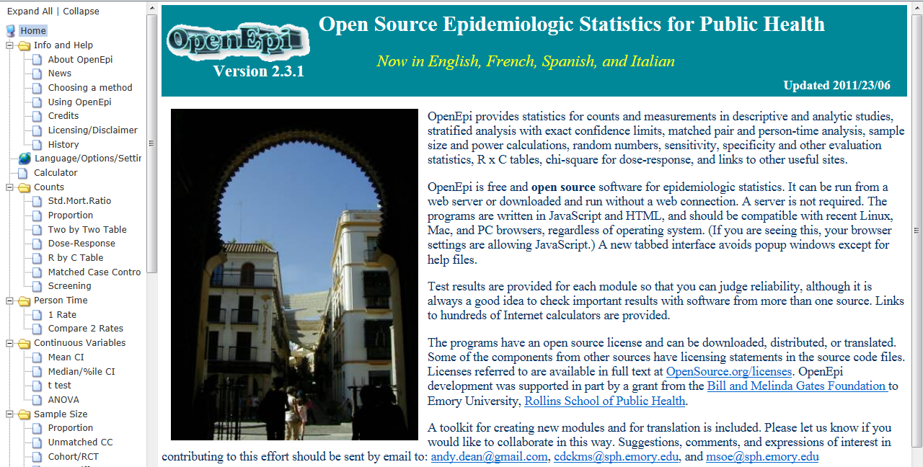
Open Source Epidemiologic Statistics for Public Health: http://www.openepi.com/OE2.3/Menu/OpenEpiMenu.htm
Notes:
Open Source Epidemiologic Statistics for Public Health: http://www.openepi.com/OE2.3/Menu/OpenEpiMenu.htm
This is a good online statistics calculator with tutorials, examples, help, and statistics calculators.
OpenEpi provides statistics for counts and measurements in descriptive and analytic studies, stratified analysis with exact confidence limits, matched pair and person-time analysis, sample size and power calculations, random numbers, sensitivity, specificity and other evaluation statistics, R x C tables, chi-square for dose-response, and links to other useful sites.

Slide 57
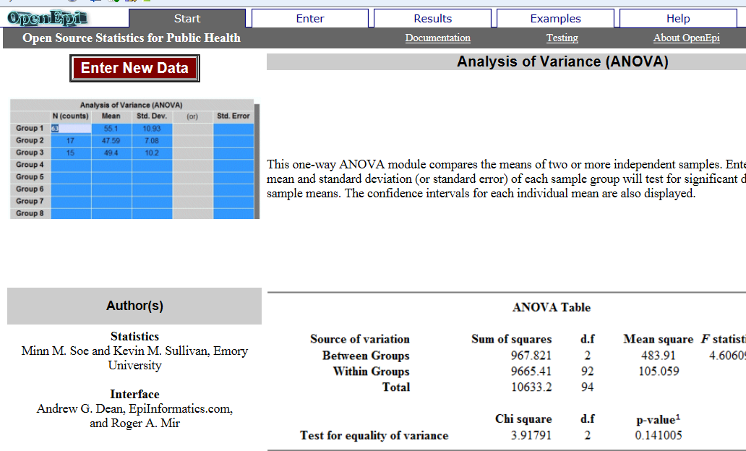
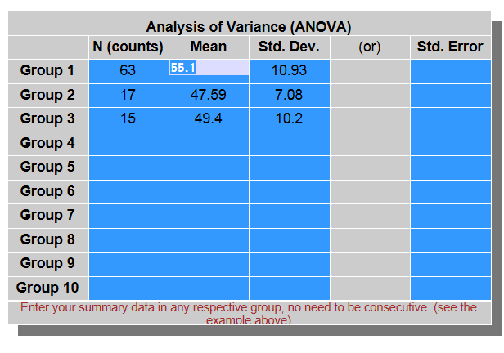
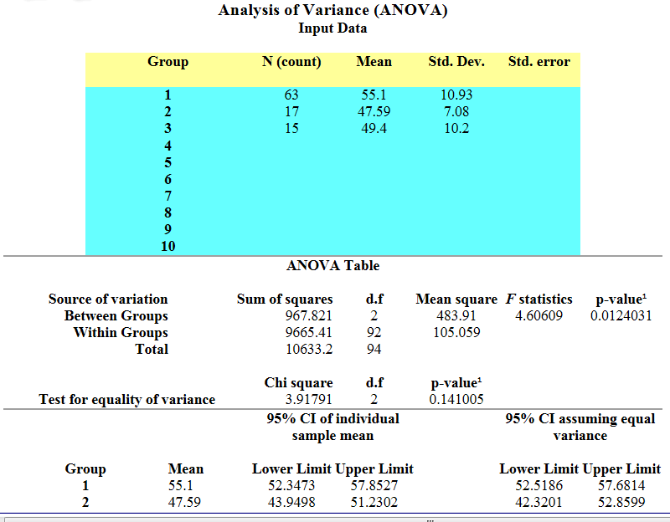
Notes:
Run through an example in the workshop using the data from the student example.
Open Source Epidemiologic Statistics for Public Health: http://www.openepi.com/OE2.3/Menu/OpenEpiMenu.htm

Slide 58
What Have We Learned in This Workshop?
Foundational concepts in statistics
Statistics is closely associated with all stages of the research process
How to decide what statistical analysis to use based on the research question and design
Some resources to determine whether findings from research are statistically significant.

Slide 59
IV. Resources and References

Slide 60
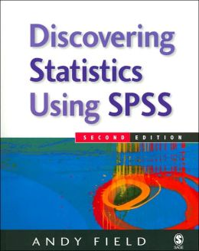
Recommended Introductory Book on Statistics
Field, A. (2005). Discovering statistics using SPSS, 3rd Ed. London: Sage Publications.

Slide 61
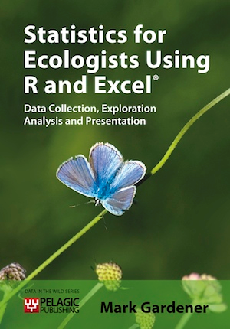
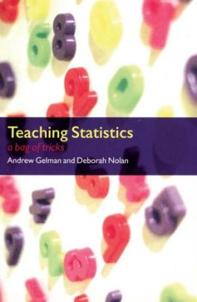
Statistics Books for Science Teachers
Gardener, M. (2012). Statistics for ecologists using R and Excel: Data collection, exploration, analysis, and presentation. Pelagic Publishing.
Gelman, A., & Nolan, D. (2002). Teaching Statistics: A Bag of Tricks: A Bag of Tricks. OUP Oxford.
Notes:
Gardener, M. (2012). Statistics for ecologists using R and Excel: Data collection, exploration, analysis, and presentation. Pelagic Publishing.
Online Supplemental Material: http://www.gardenersown.co.uk/Education/Lectures/S4E%20support.htm
Gelman, A., & Nolan, D. (2002). Teaching Statistics: A Bag of Tricks. OUP Oxford.

Slide 62
Online Resources and Links
Biostatistics & Data Management Core: John A. Burns School of Medicine, UH Manoa: http://biostat.jabsom.hawaii.edu/
  Provides useful links to other statistics websites and self-help statistical resources.
Rice Virtual Lab in Statistics: http://onlinestatbook.com/rvls.html
  Offers demonstrations and examples
Free Internet Resources for school teachers to use in their classroom: http://www.stat.auckland.ac.nz/~iase/islp/priclass
Teaching Resources for Statistics: http://www.statsci.org/teaching.html

Slide 63
Online Statistical Decision Trees
GraphPad Software: “REVIEW OF AVAILABLE STATISTICAL TESTS” http://www.graphpad.com/support/faqid/1790/
  Provides an excellent simple table to decide on statistical test based on the type of goal of the research question or study and the type of data collected.
THE DECISION TREE FOR STATISTICS: http://www.microsiris.com/Statistical%20Decision%20Tree/default.htm
  This is a good online resource to help guide you through what type of statistical analysis to use based on research design and type of data collected.
Social Research Methods Selecting Statistics Decision Tree: http://www.socialresearchmethods.net/selstat/ssstart.htm

Slide 64
Online Statistics Calculators
ABCalc: http://wps.ablongman.com/ab_levinfox_essentials_2/75/19394/4964873.cw/index.html
  Program that is run in Microsoft Excel that can be downloaded to perform basic statistical analyses with raw and summary data.
Open Source Epidemiologic Statistics for Public Health: http://www.openepi.com/OE2.3/Menu/OpenEpiMenu.htm
  This is a good online statistics calculator with tutorials, examples, help, and statistics calculators.
Graphpad: http://www.graphpad.com/
  Data analysis resource center and online statistics calculators.
Kid’s Zone Create a Graph: http://nces.ed.gov/nceskids/createagraph/default.aspx
  Online resource for creating graphs and charts.

Slide 65
Online Data Visualization Tools for Qualitative Data
Wordle: http://www.wordle.net/
  Wordle is a toy for generating “word clouds” from text that you provide. The clouds give greater prominence to words that appear more frequently in the source text.
Many Eyes: http://www-958.ibm.com/software/data/cognos/manyeyes/
  Many Eyes is an online data visualization tool by the IBM Research and the IBM Cognos software group.

Slide 66
Workshop Post Evaluation

Slide 67
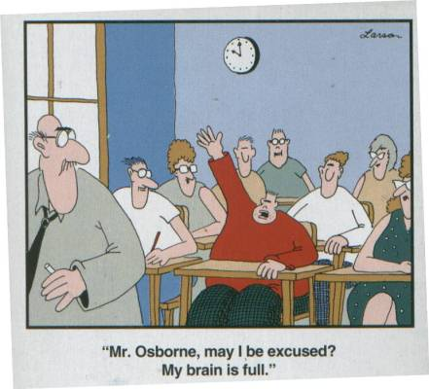

Slide 68
Thank You for Your Time and Attention
Any Questions?
rtolman@hawaii.edu

